Slide 1
Array, Array List, Vector Session 3 & 4
Course : COMP 6175
Object Oriented Programming
Effective Period : October 2018

Slide 2
Outline
Array Definition
Array Declaration
Two dimensional array
ArrayList
Vector
ArrayList Vs Vector

Slide 3
Array Definition
A group of homogeny data type with fix dimension and sequential.
Store linear collections of elements.
Part of data structure.
Declaration group variable efficiently.
Access by index.

Slide 4
Array Illustration
double[] myList = new double[10];
myList[0]
5.6
4.5
3.3
13.2
4.0
34.33
34.0
45.45
99.993
11123
myList array has own 10 data double type element with
index 0 to 9
myList[1]
myList[2]
myList[3]
myList[4]
Element (at index 5)
myList[5]
Element value
myList[6]
myList[7]
myList[8]
myList[9]

Slide 5

Array Initialization
Automatic initialization
Manual initialization
Example of Array data char type:
char[] city = {‘D’,’a’,’l’,’l’,’a’,’s’};
System.out.println(city);
Example of Array for String:
String[] name={"Andre", "Bunga", "Christine", "Dony"};
System.out.println(name[0]);
System.out.println(name[1]);

Slide 6
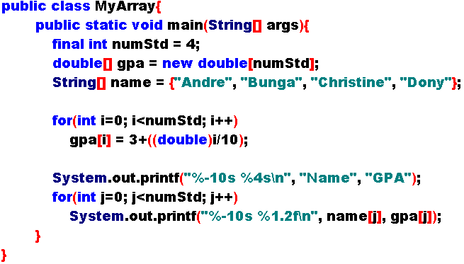
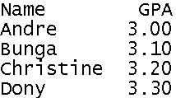
Simple Sample of Single Array

Slide 7
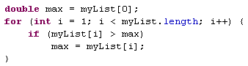
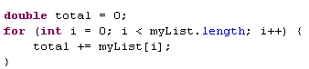
Processing an Array
Need looping, because of:
Element array has uniform data type can process repeatedly by the same way.
Known Array size support looping process.
Example of biggest number searching:
Example of summarization:

Slide 8
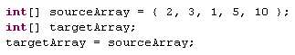
Array Duplication (Incorrect Way)
Duplicate content of array to another array.
Incorrect way:

Slide 9
Array Duplication (Incorrect Way) Cont’
Before targetArray = source Array;
After targetArray = source Array;
sourceArray
Content of sourceArray
2, 3, 1, 5, 10
sourceArray
Content of sourceArray
2, 3, 1, 5, 10
targetArray
targetArray
Content of targetArray
?
Content of targetArray
?

Slide 10
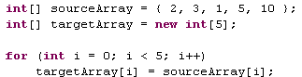
Array Duplication (Correct Way)
Correct way:
Using looping
Using arraycopy from System
Using clone
Example of using looping:

Slide 11
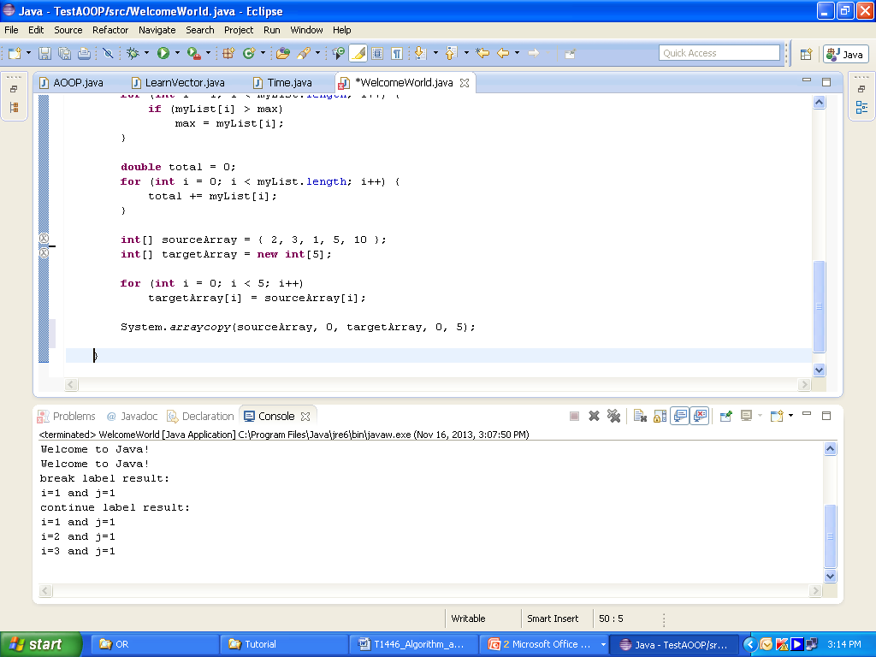
Array Duplication (Correct Way)
Total data
will be copied
Example of using arraycopy:
Source position
Destination position

Slide 12
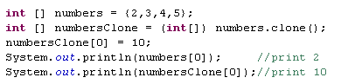
Array Duplication (Correct Way)
Example of using clone:
The value of numbers didn’t change because they have different references.

Slide 13
Correct Way of Duplicating Array Illustration
arraycopy not allocated memory automatically.
arraycopy against names convention, should be arrayCopy.
Before copy
After copy
sourceArray
content sourceArray
2, 3, 1, 5, 10
sourceArray
contentsourceArray
2, 3, 1, 5, 10
targetArray
content targetArray
?
targetArray
content targetArray
2, 3, 1, 5, 10

Slide 14
Two Dimensional Array
Store a matrix or a table.
For example:
Distance Table (in miles)
 | Chicago | Boston | New York | Atlanta | Miami
Chicago | 0 | 983 | 787 | 714 | 1375
Boston | 983 | 0 | 214 | 1102 | 1763
New York | 787 | 214 | 0 | 888 | 1549
Atlanta | 714 | 1102 | 888 | 0 | 661
Miami | 1375 | 1763 | 1549 | 661 | 0

Slide 15
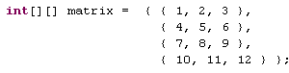
Initializing Two-Dimensional Array
For Example:
Will create:
 | [0] | [1] | [2]
[0] | 1 | 2 | 3
[1] | 4 | 5 | 6
[2] | 7 | 8 | 9
[3] | 10 | 11 | 12
Orientation [row][column] , thus, matrix[2][1] value 8

Slide 16
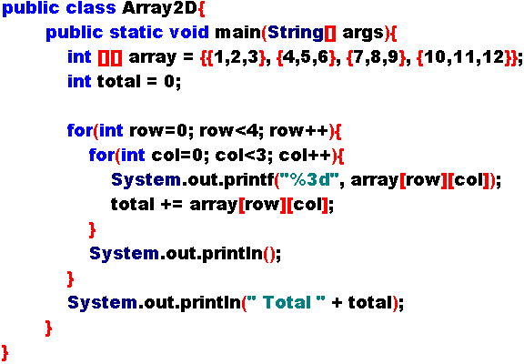
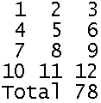
Sample of Processing Two-Dimensional Array
Process array 2 dimension (example all value summation)

Slide 17
Did You Know?
Maximum value for array dimension
2GB – 1 → ( 2 * 1024 * 1024 * 1024) – 1 → 2147483648 – 1 → 2147483647
So array dimension maximum:
boolean bool = new boolean[2147483647];
int i = new int[2147483647];
long l = new long[2147483647];
Array unitization has default value:
boolean → false
numeric (byte, int, long, float, double) → 0
char → ‘\x000’ (ASCII 0)
String → “null”

Slide 18
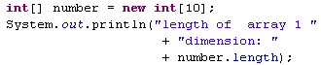
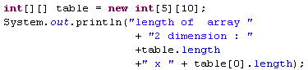
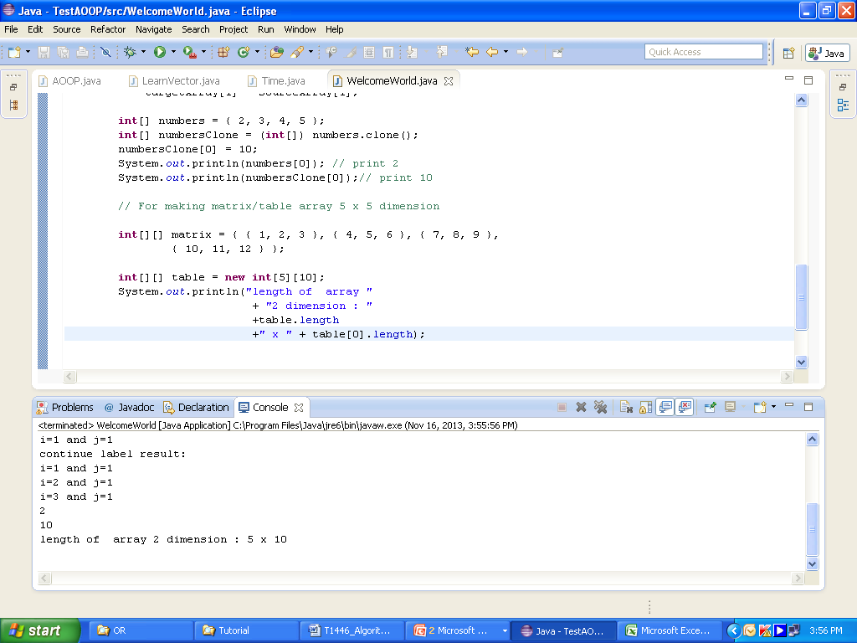
Did You Know?
To know length of array can use array.length
Example:
Array 1 dimension:
Array 2 dimension:

Slide 19
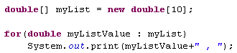
Advanced Learning (1)
Java provided with foreach loop.
high level looping.
Enable to search array without index.
Example:
myListValue become reference from myList.
Value of myListValue automatically begin from index 0 s/d n-1 at looping.

Slide 20
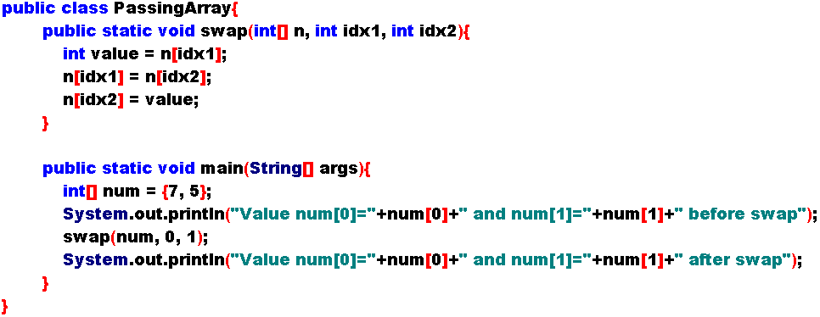
Passing Arrays

Slide 21
Return Arrays
Return value can in form of array
Data type array receiver and data type array that returned must similar.
Array receiver unnecessary to initialize
Size of array receiver will be similar with size of array that returned.

Slide 22
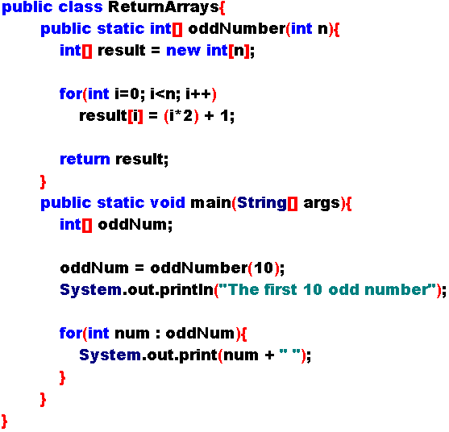

Return Arrays

Slide 23
ArrayList Class
ArrayList made to overcome the problems faced by the Array in determining its size because it is a dynamic ArrayList.
The following functions are frequently used in the ArrayList class
add(element) → adding element to the list
clear() → delete all element in the list
clone() → returns the copied object in the list
contains(element) → searching element contains in the list
get(index) → take a certain element at index in list
isEmpty() → to check whether the list is empty or not
remove(index) → to remove the designated element in the list
size() → number of element in the list
set(index, element) → fill an element in the list in accordance with the designated position

Slide 24
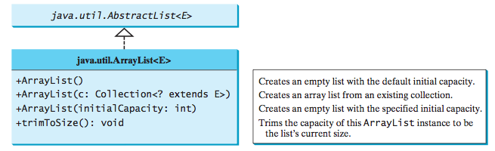
ArrayList Class Design

Slide 25
Vector Class
Inheritance and same implement with ArrayList
Also dynamic in size (growable).
Each vector tries to optimize storage management by maintaining its capacity
Including one part of java framework collection
Declaration :
Vector v = new Vector();

Slide 26
Methods in Vector Class
The following functions are frequently used in the vector class
addElement(element) → adding element to the final sequence of the vector
capacity() → restore the capacity vector
clone() → restore objek coppied in that vector
containts(element) → searching element in the vector
copyInto(element[]) → copy element ke specific array
elementAt(index) → take the element of the designated index
insertElementAt(element , index) → add an element to the designated index
isEmpty() → check whether the vector is empty or not
remove(index) → remove the designated element in the vector
size() → number of elements in vector
set(index, element) → fills a vector element in accordance with the designated position
Almost all function in Vector are the same with functions in class List, because Vector mostly implement from class List (interface). And also identically the same with ArrayList.

Slide 27
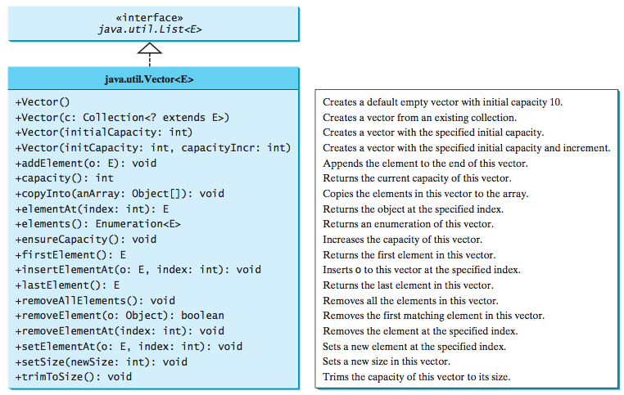
Vector Class Design

Slide 28
ArrayList Vs Vector
Each method Vector given keyword “synchronized”, so that when executed in the Thread, it will not happen Thread congestion.
In ArrayList every method not given keyword “synchronized”, so when executed in Thread, this can resulted unsafe Thread, in other words collision of Thread can occur, when Thread try to call ArrayList Method.
Time used by ArrayList is shorter as compared to Vector.
If we want to create dynamic array run using a Thread, use Vector. Whereas if indeed the process that we do not need to use threads, then use the ArrayList to faster processing of dynamic arrays.

Slide 29
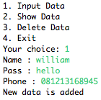
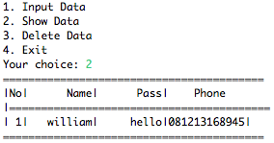
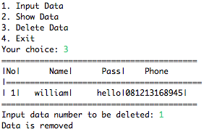
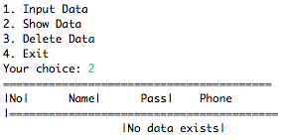
Exercise
Create a program that allows to receive multiples entry data, shows the data from the list, and delete from the list as following

Slide 30
References
Introduction to Java Programming. 10ed. Liang. 2015. Chapter Chapter 7-8
Java by Example. Jerry. 1996. Chapter 6
Java Software Solutions. 5ed. Lewis & Loftus. 2007. p400-410
http://java.sun.com/docs/books/tutorial/java/nutsandbolts/arrays.html
http://xahlee.org/java-a-day/arrays.html

